Slide 1
Chapter 4: Command-Line Administration Tools
Instructor-led overview and operational guidance

Slide 2
Learning Objectives
01 Explain the key administrative ideas
02 Identify the relevant Windows Server tools, workflows, and decision points
03 Relate the topic set to real operational and security practices
04 Prepare for later hands-on administration and troubleshooting work
Windows Server 2025 | Chapter 4 | Command-Line Administration Tools
02

Slide 3
Chapter Topics
01 4.1 Command-line hosts
02 4.2 Windows Terminal
03 4.3 CMD.EXE
04 4.4 PowerShell
Windows Server 2025 | Chapter 4 | Command-Line Administration Tools
03

Slide 4


4.1 Command-line hosts
Command-line hosts present console-based interaction.
Command-line hosts are the environments that present console-based interaction for commands, shells, and tools
Console windows and host processes
Input, output, and buffering behavior
Relationship between host and shell
Windows Server 2025 | Chapter 4 | Command-Line Administration Tools
04

Slide 5
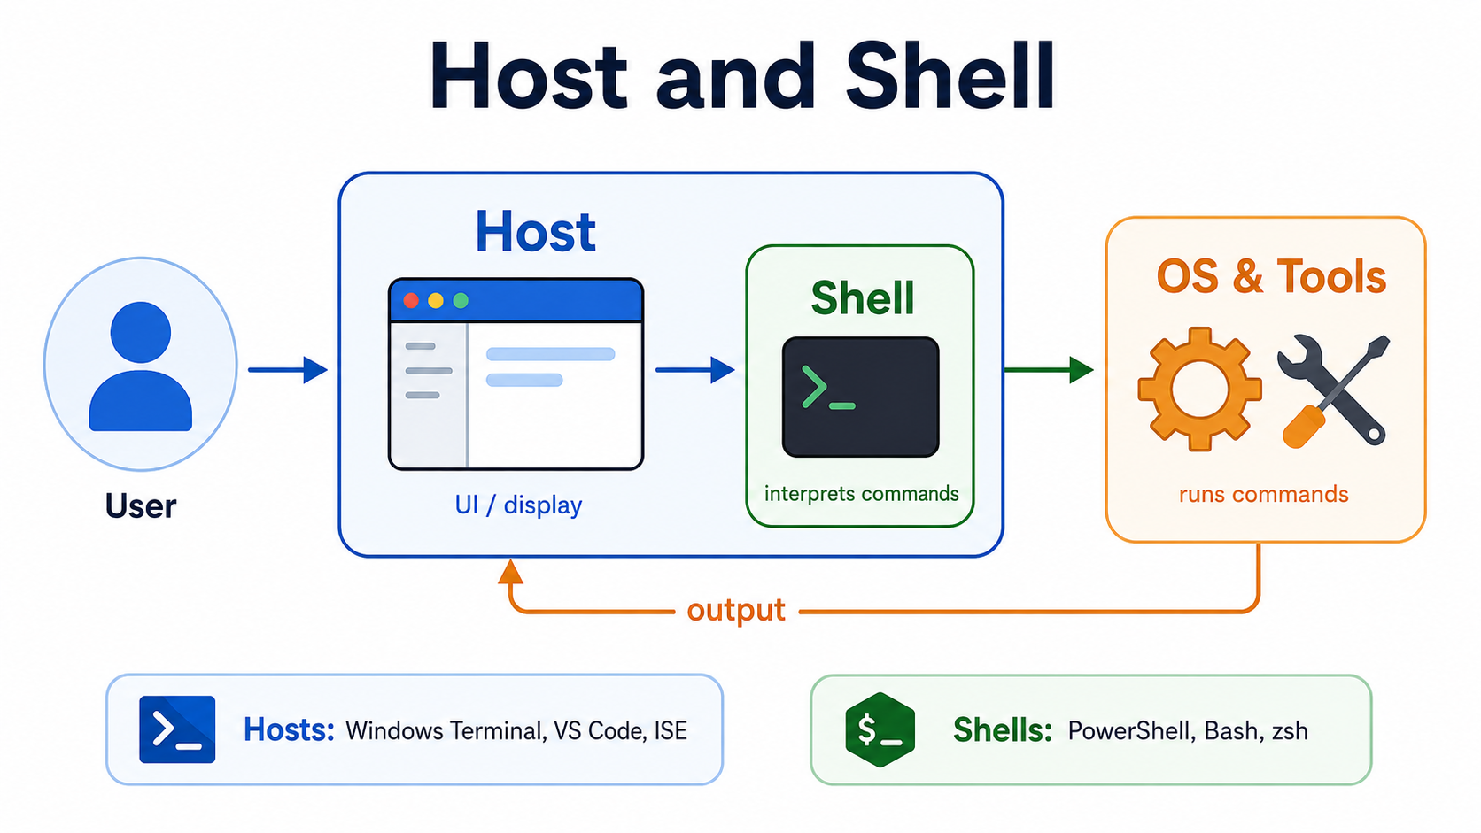

Slide 6

4.2 Windows Terminal
Windows Terminal is the modern multi-tab console host.
Windows Terminal is the modern multi-tab host for command-line environments such as PowerShell, CMD, and SSH sessions
Profiles and tabs
Rendering engine and terminal settings
Support for multiple shells in one interface
Windows Server 2025 | Chapter 4 | Command-Line Administration Tools
05

Slide 7
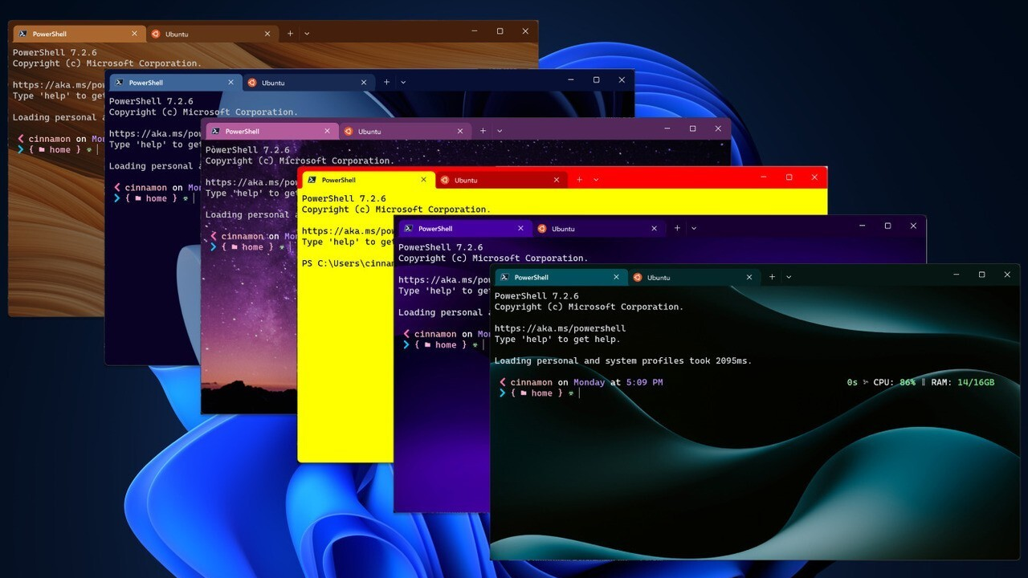
Windows Terminal
Windows Server 2025 | Chapter 4 | Command-Line Administration Tools
06

Slide 8
4.3 CMD.EXE
CMD.EXE is the classic command interpreter.
CMD.EXE remains the classic Windows command interpreter and still matters for compatibility, legacy scripts, and basic administrative tasks
Batch file execution
Environment variables and command chaining
Compatibility with long-standing Windows commands
Windows Server 2025 | Chapter 4 | Command-Line Administration Tools
07

Slide 9
4.4 PowerShell
PowerShell is the primary administration platform.
PowerShell is the primary command-line and automation platform for Windows Server administration
Cmdlets and modules
Pipelines and objects
Remoting and scripting support
Windows Server 2025 | Chapter 4 | Command-Line Administration Tools
08

Slide 10
Module overview
In this Module, you’ll learn about PowerShell’s system requirements and how to open and configure commonly used host applications, including the Windows PowerShell console and Windows PowerShell Integrated Scripting Environment (ISE). Finally, you’ll discover how you can use Microsoft Visual Studio Code (VS Code) to develop PowerShell scripts.
Units:
Windows PowerShell introduction
Windows PowerShell versions
Windows PowerShell applications
Considerations when using PowerShell
Configuring the PowerShell console
Demonstration: Configuring the console
Configuring the ISE
Demonstration: Configuring the ISE
Using Visual Studio Code with PowerShell
Windows Server 2025 | Chapter 4 | Command-Line Administration Tools
09

Slide 11
Windows PowerShell Introduction
PowerShell is an automation solution that consists of:
A command-line shell
A scripting language
A configuration management framework
Commands include:
Cmdlets
Functions
Filters
Workflows
PowerShell was originally built on the .NET framework and only worked on Windows operating systems.
It currently uses the .NET Core and can run on Windows, MacOS, and Linux platforms.
Windows Server 2025 | Chapter 4 | Command-Line Administration Tools
10

Slide 12
Windows PowerShell versions (Slide 2)
Version | Release date | Notes
PowerShell 3.0 | October 2012 | Integrated in Windows 8 and Windows Server 2012. Can be installed on Windows 7 SP1, Windows Server 2008 SP1, and Windows Server 2008 R2 SP1.
PowerShell 2.0 | July 2009 | Integrated in Windows 7 and Windows Server 2008 R2. Can be installed on Windows XP SP3, Windows Server 2003 SP2, and Windows Vista SP1.
PowerShell 1.0 | November 2006 | Installable on Windows XP SP2, Windows Server 2003 SP1, and Windows Vista. Optional component of Windows Server 2008.
Windows Server 2025 | Chapter 4 | Command-Line Administration Tools
11

Slide 13
Windows PowerShell versions
Version | Release date | Notes
PowerShell 7.2 | November 2021 | Built on .NET 6.0.
PowerShell 7.1 | November 2020 | Built on .NET 5.0.
PowerShell 7.0 | March 2020 | Built on .NET Core 3.1.
PowerShell 6.0 | September 2018 | Built on .NET Core 2.0. First release that’s installable on Windows, Linux, and macOS.
PowerShell 5.1 | August 2016 | Released in Windows 10 Anniversary Update and Windows Server 2016 and as part of Windows Management Framework (WMF) 5.1.
PowerShell 5.0 | February 2016 | Integrated in Windows 10 version 1511. Released in Windows Management Framework (WMF) 5.0. Can be installed on Windows Server 2008 R2, Windows Server 2012, Windows 10, Windows 8.1 Enterprise, Windows 8.1 Pro, and Windows 7 SP1.
PowerShell 4.0 | October 2013 | Integrated in Windows 8.1 and Windows Server 2012 R2. Can be installed on Windows 7 SP1, Windows Server 2008 SP1, and Windows Server 2012.
Windows Server 2025 | Chapter 4 | Command-Line Administration Tools
12

Slide 14
PowerShell 5.1 vs PowerShell 7+
Windows PowerShell 5.1
PowerShell 7+
Engine
.NET Framework 4.x
Windows-only
.NET 6/7/8 (Core)
Cross-platform (Win/Linux/Mac)
Install path
C:\Windows\System32\WindowsPowerShell\v1.0\
C:\Program Files\PowerShell\7\
Module support
All Windows modules, including legacy WMI & ActiveDirectory cmdlets
Most cross-platform modules; some Windows modules via Compatibility layer (WinPS)
Coexistence
Installed as part of OS
Cannot be removed
Runs as powershell.exe
Side-by-side install
Does not replace 5.1
Runs as pwsh.exe
Use case
Managing Windows roles
Legacy automation
Active Directory admin
Modern scripting & DevOps
Cross-platform automation
Azure & cloud tooling
Windows Server 2025 | Chapter 4 | Command-Line Administration Tools
13

Slide 15
Considerations when using PowerShell
When using PowerShell, you should:
Install and use PowerShell side-by-side with Windows PowerShell:
PowerShell uses a separate installation path and executable name (pwsh.exe).
PowerShell uses a separate PSModulePath, profile, and event logs.
You identify the PowerShell version by using $PSVersionTable.
Run PowerShell using Administrative credentials:
64-bit operating systems include both 64-bit and 32-bit versions of PowerShell.
The Windows title bar must display Administrator if you need administrative privileges in Windows PowerShell.
When UAC is enabled, you must right-click the application icon or activate its context menu to run as Administrator.
Identify and modify the execution policy in PowerShell:
Use Get-ExecutionPolicy to identify the effective execution policy in PowerShell.
Be aware that Restricted is the default for Windows clients and RemoteSigned is the default for Windows servers.
Windows Server 2025 | Chapter 4 | Command-Line Administration Tools
14

Slide 16
Using Visual Studio Code with PowerShell
Visual Studio Code is a Microsoft Script Editor that offers a similar experience to the PowerShell ISE when you’re using the PowerShell extension add-on.
Supports the following:
PowerShell Core 6, 7, and newer for Windows, macOS, and Linux.
PowerShell 5.1 for Windows.
Supports ISE mode, which enables:
Mapping keyboard functions in VS Code so they match those used in the ISE.
Replicating the VS Code user interface to resemble the ISE.
Enabling ISE-like tab completion.
Providing several ISE themes to make the VS Code editor look like the ISE.
Windows Server 2025 | Chapter 4 | Command-Line Administration Tools
15

Slide 17
Module overview
In this Module, you’ll learn about the Windows PowerShell pipeline and some basic techniques for running multiple commands in it. Running commands individually is both cumbersome and inefficient. Understanding how the pipeline works is fundamental to your success in using Windows PowerShell for administration.
Units:
What is the pipeline?
Pipeline output
Discovering object members
Demonstration: Reviewing object members
Formatting pipeline output
Demonstration: Formatting pipeline output
Windows Server 2025 | Chapter 4 | Command-Line Administration Tools
16

Slide 18
What is the pipeline?
Consider the following regarding the PowerShell pipeline:
Windows PowerShell runs commands in a pipeline.
Each console command line is a pipeline.
Commands are separated by a pipe character (|).
Commands execute from left to right.
Output of each command is piped (passed) to the next.
The output of the last command in the pipeline is what you notice on your screen.
Piped commands typically follow the pattern Get |Set, Get | Where, or Select | Set.
Windows Server 2025 | Chapter 4 | Command-Line Administration Tools
17

Slide 19
What is the pipeline? (Slide 2)
PowerShell objects can be compared to real-world items.
For example, consider a car as an object. The car’s attributes can be described as engine, car color, car size, type, make and model. In PowerShell, these would be known as properties.
Properties of the object could be, in turn, objects themselves. For instance, the engine property is also an object with attributes, such as pistons, spark plugs, crankshaft, etc.
Objects have actions, corresponding to opening or closing doors, changing gears, accelerating, and applying brakes. In PowerShell, these actions are called methods.
Windows Server 2025 | Chapter 4 | Command-Line Administration Tools
18

Slide 20
Pipeline output
Windows PowerShell commands produce objects as their output.
An object is like a table of data in memory.
Allows the Get | Set pattern to work.
Property
Collection
Name | Status | DisplayName
WinRM | Running | Windows Remote Management
VDS | Running | Virtual Disk
Object
Windows Server 2025 | Chapter 4 | Command-Line Administration Tools
19

Slide 21
Discovering object members
1
Object members include:
Properties
Methods
Events
2
Run a command that produces an object, and pipe that object to Get-Member to review a list of members.
3
Get-Member is a discovery tool that’s similar to Help. You can use it to learn how to use the shell.
Windows Server 2025 | Chapter 4 | Command-Line Administration Tools
20

Slide 22
Demonstration Plan
Review the most relevant management interface for the chapter topics
Run one or more validating PowerShell examples
Explain operational dependencies and expected results
Connect the chapter concepts to later administration work
Windows Server 2025 | Chapter 4 | Command-Line Administration Tools
21

Slide 23
Chapter Summary
01 Establish command-line administration as normal practice rather than an advanced niche
02 Differentiate console hosts, shells, and scripting environments
03 Put PowerShell at the center while still covering CMD compatibility and Windows Terminal
04 Reinforce repeatable administration, validation, and supportable design choices
Windows Server 2025 | Chapter 4 | Command-Line Administration Tools
22

Slide 24
Knowledge Check
01 What is the main administrative purpose of Command-line hosts?
02 What is the main administrative purpose of Windows Terminal?
03 What is the main administrative purpose of CMD.EXE?
04 What is the main administrative purpose of PowerShell?
Windows Server 2025 | Chapter 4 | Command-Line Administration Tools
23

Slide 25

Lab 0401 | PowerShell Command-Line Administration
PowerShell Command-Line Administration
In this lab, you will explore PowerShell as a command-line administration tool. You will learn to use cmdlets, pipe commands together, retrieve system information, and understand why PowerShell is the modern standard for Windows Server administration. This lab builds on Lab 0201 and provides hands-on experience with essential PowerShell skills.
Windows Server 2025 | Chapter 4 | Command-Line Administration Tools
24

